Slide 1
Module 4: Processes
Process Concept
Process Scheduling
Operation on Processes
Cooperating Processes
Interprocess Communication

Slide 2
Process Concept
An operating system executes a variety of programs:
  Batch system – jobs
  Time-shared systems – user programs or tasks
Textbook uses the terms job and process almost interchangeably.
Process – a program in execution; process execution must progress in sequential fashion.
A process includes:
  program counter
  stack
  data section

Slide 3
Process State
As a process executes, it changes state
  new: The process is being created.
  running: Instructions are being executed.
  waiting: The process is waiting for some event to occur.
  ready: The process is waiting to be assigned to a process.
  terminated: The process has finished execution.

Slide 4
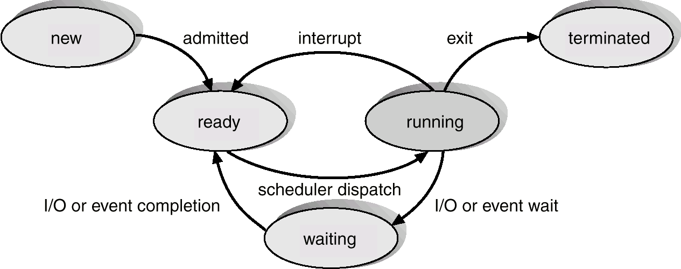
Diagram of Process State

Slide 5
Process Control Block (PCB)
Information associated with each process.
Process state
Program counter
CPU registers
CPU scheduling information
Memory-management information
Accounting information
I/O status information

Slide 6
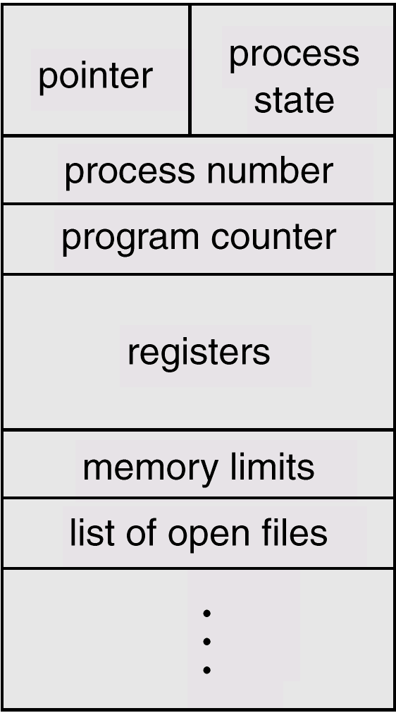
Process Control Block (PCB)

Slide 7
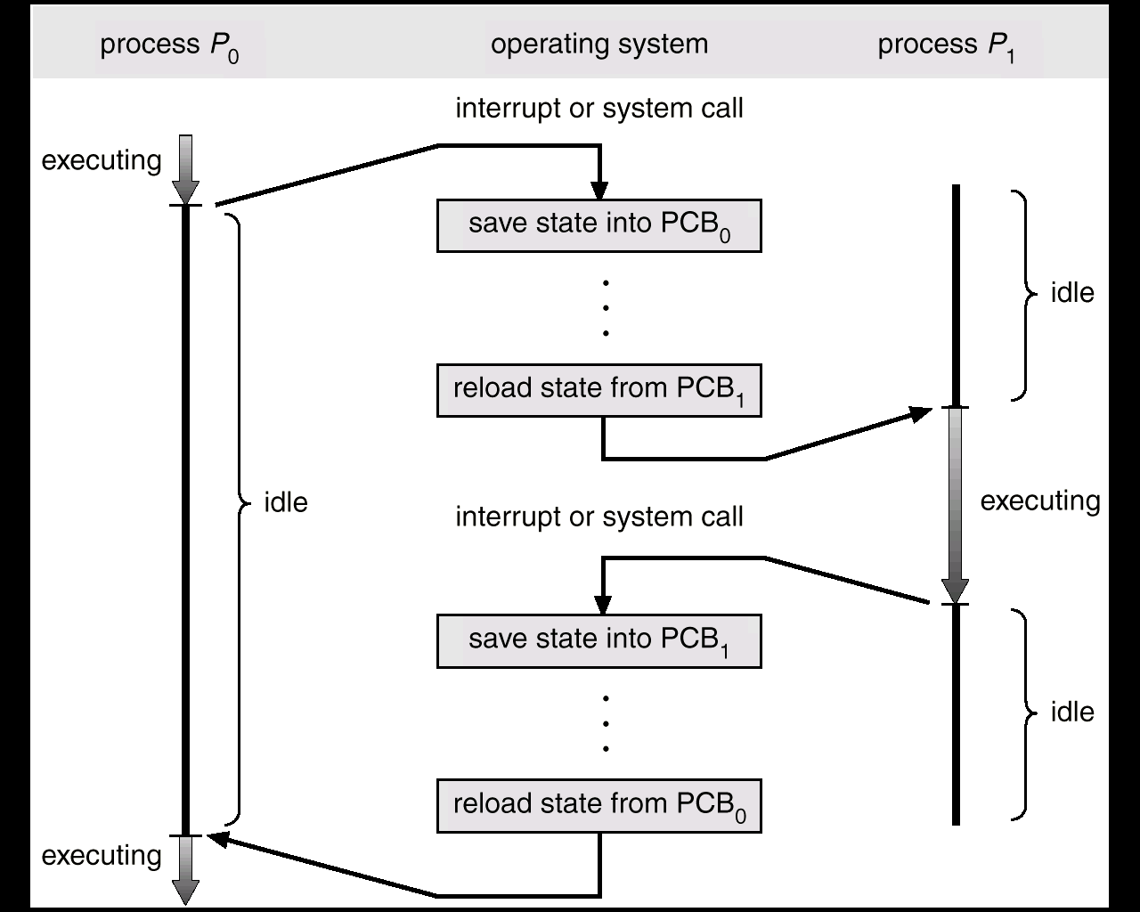
CPU Switch From Process to Process

Slide 8
Process Scheduling Queues
Job queue – set of all processes in the system.
Ready queue – set of all processes residing in main memory,
ready and waiting to execute.
Device queues – set of processes waiting for an I/O device.
Process migration between the various queues.

Slide 9
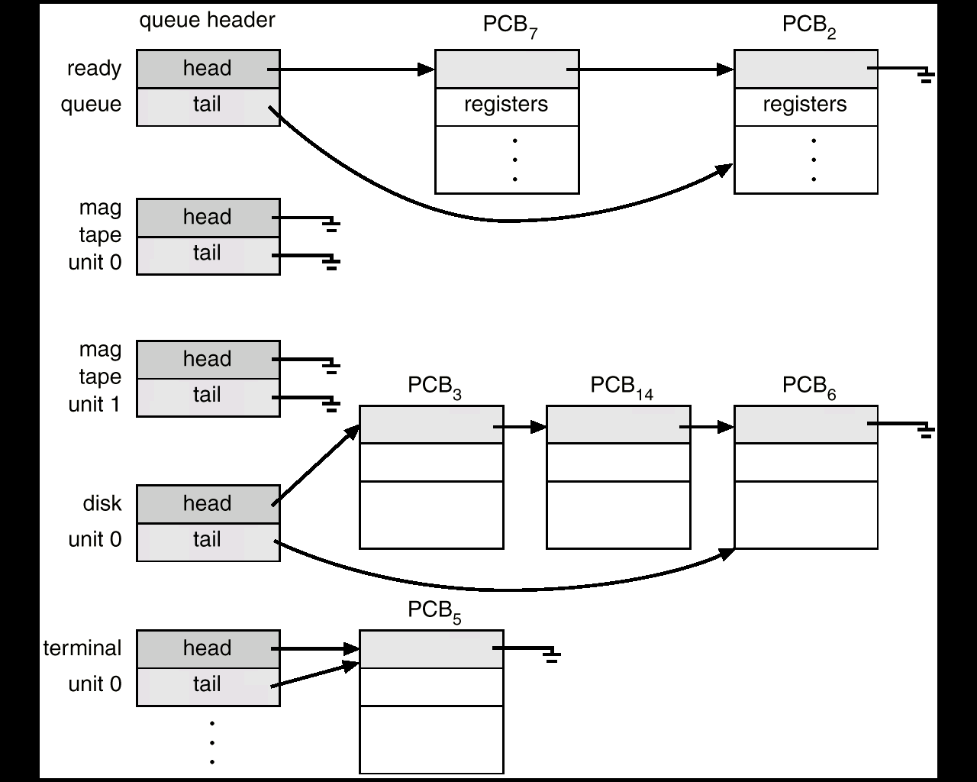
Ready Queue And Various I/O Device Queues

Slide 10
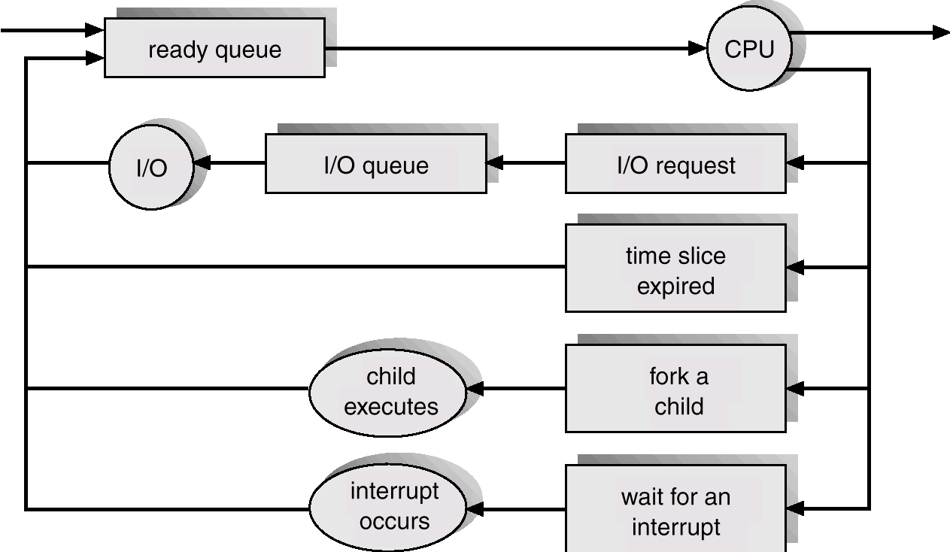
Representation of Process Scheduling

Slide 11
Schedulers
Long-term scheduler (or job scheduler) – selects which processes should be brought into the ready queue.
Short-term scheduler (or CPU scheduler) – selects which process should be executed next and allocates CPU.

Slide 12
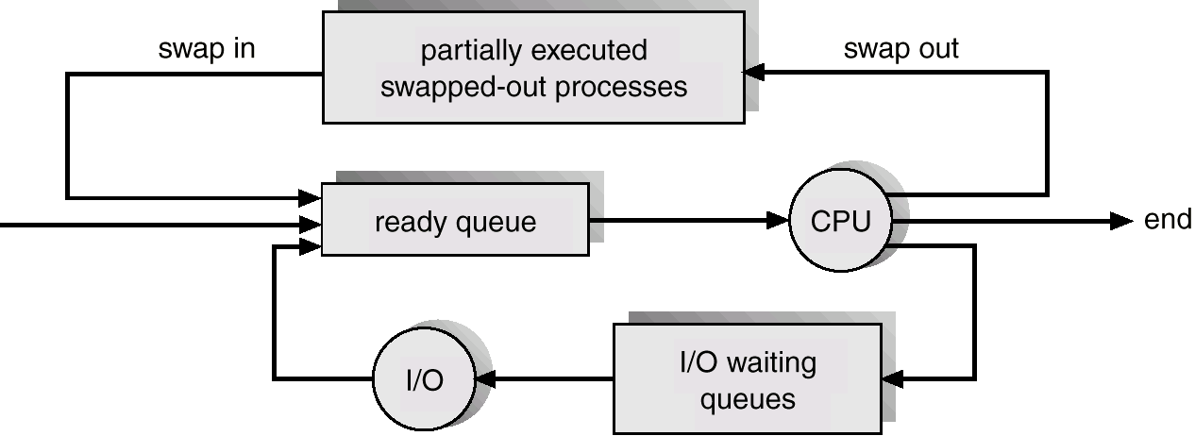
Addition of Medium Term Scheduling

Slide 13
Schedulers (Cont.)
Short-term scheduler is invoked very frequently (milliseconds)
⇒ (must be fast).
Long-term scheduler is invoked very infrequently (seconds, minutes) ⇒ (may be slow).
The long-term scheduler controls the degree of multiprogramming.
Processes can be described as either:
  I/O-bound process – spends more time doing I/O than computations, many short CPU bursts.
  CPU-bound process – spends more time doing computations; few very long CPU bursts.

Slide 14
Context Switch
When CPU switches to another process, the system must save the state of the old process and load the saved state for the new process.
The Context of a process is represented in the PCB of a process.
When a context switch occurs, the kernel saves the context of a old process in its PCB and loads the saved context of the new process schedule to run.
Context-switch time is overhead; the system does no useful work while switching.
Switching Time dependent on hardware support.

Slide 15
Process Creation
Parent process creates children processes, which, in turn create other processes, forming a tree of processes.
Resource sharing
  Parent and children share all resources.
  Children share subset of parent’s resources.
  Parent and child share no resources.
Execution
  Parent and children execute concurrently.
  Parent waits until children terminate.

Slide 16
Process Creation (Cont.)
Address space
  Child duplicate of parent.
  Child has a program loaded into it.
UNIX examples
  fork system call creates new process
  execve system call used after a fork to replace the process’ memory space with a new program.

Slide 17
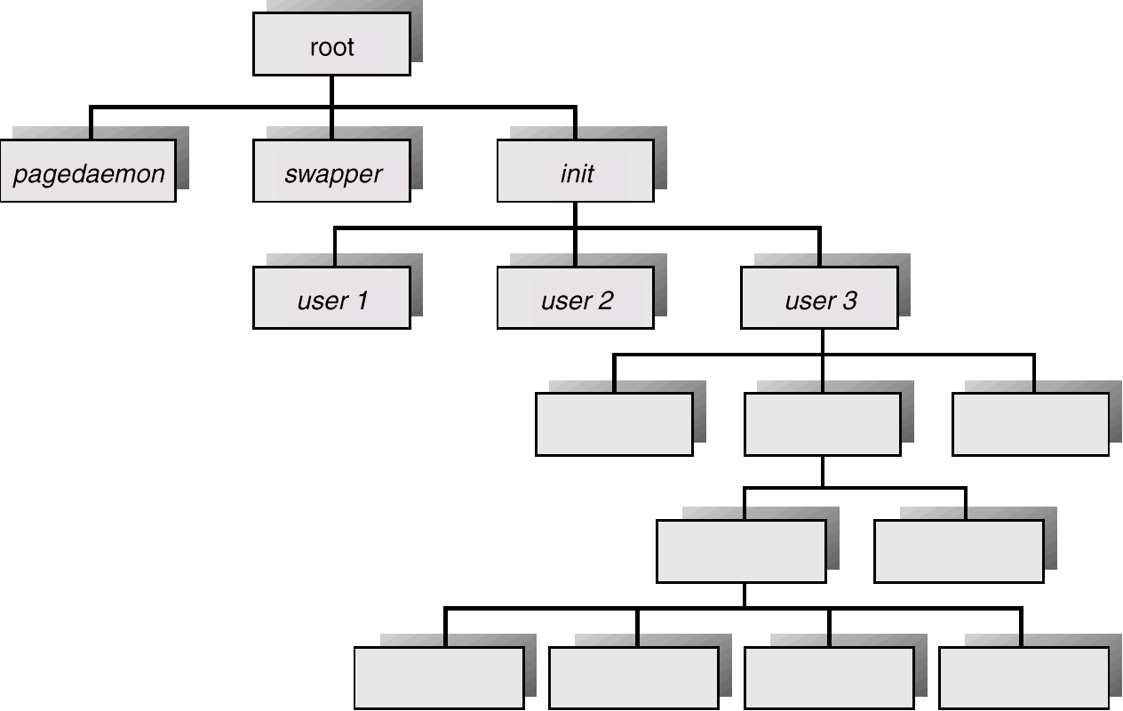
A Tree of Processes On A Typical UNIX System

Slide 18
Process Termination
Process executes last statement and asks the operating system to decide it (exit).
  Output data from child to parent (via wait).
  Process’ resources are deallocated by operating system.
Parent may terminate execution of children processes (abort).
  Child has exceeded allocated resources.
  Task assigned to child is no longer required.
  Parent is exiting.
    Operating system does not allow child to continue if its parent terminates.
    Cascading termination.

Slide 19
Cooperating Processes
Independent process cannot affect or be affected by the execution of another process.
Cooperating process can affect or be affected by the execution of another process
Advantages of process cooperation
  Information sharing
  Computation speed-up
  Modularity
  Convenience

Slide 20
Producer-Consumer Problem
Paradigm for cooperating processes, producer process produces information that is consumed by a consumer process.
  unbounded-buffer places no practical limit on the size of the buffer.
  bounded-buffer assumes that there is a fixed buffer size.

Slide 21
Bounded-Buffer – Shared-Memory Solution
Shared data
      var n;
      type item = … ;
      var buffer. array [0..n–1] of item;
        in, out: 0..n–1;
Producer process
      repeat
        …
        produce an item in nextp
        …
        while in+1 mod n = out do no-op;
        buffer [in] :=nextp;
        in :=in+1 mod n;
      until false;

Slide 22
Bounded-Buffer (Cont.)
Consumer process
      repeat
        while in = out do no-op;
        nextc := buffer [out];
        out := out+1 mod n;
        …
        consume the item in nextc
        …
        until false;
Solution is correct, but can only fill up n–1 buffer.

Slide 23
Threads
A thread (or lightweight process) is a basic unit of CPU utilization; it consists of:
  program counter
  register set
  stack space
A thread shares with its peer threads its:
  code section
  data section
  operating-system resources
  collectively know as a task.
A traditional or heavyweight process is equal to a task with one thread

Slide 24
Threads (Cont.)
In a multiple threaded task, while one server thread is blocked and waiting, a second thread in the same task can run.
  Cooperation of multiple threads in same job confers higher throughput and improved performance.
  Applications that require sharing a common buffer (i.e., producer-consumer) benefit from thread utilization.
Threads provide a mechanism that allows sequential processes to make blocking system calls while also achieving parallelism.
Kernel-supported threads (Mach and OS/2).
User-level threads; supported above the kernel, via a set of library calls at the user level (Project Andrew from CMU).
Hybrid approach implements both user-level and kernel-supported threads (Solaris 2).

Slide 25
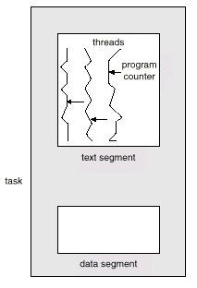
Multiple Threads within a Task

Slide 26
Threads Support in Solaris 2
Solaris 2 is a version of UNIX with support for threads at the kernel and user levels, symmetric multiprocessing, and
real-time scheduling.
LWP – intermediate level between user-level threads and kernel-level threads.
Resource needs of thread types:
  Kernel thread: small data structure and a stack; thread switching does not require changing memory access information – relatively fast.
  LWP: PCB with register data, accounting and memory information,; switching between LWPs is relatively slow.
  User-level thread: only ned stack and program counter; no kernel involvement means fast switching. Kernel only sees the LWPs that support user-level threads.

Slide 27
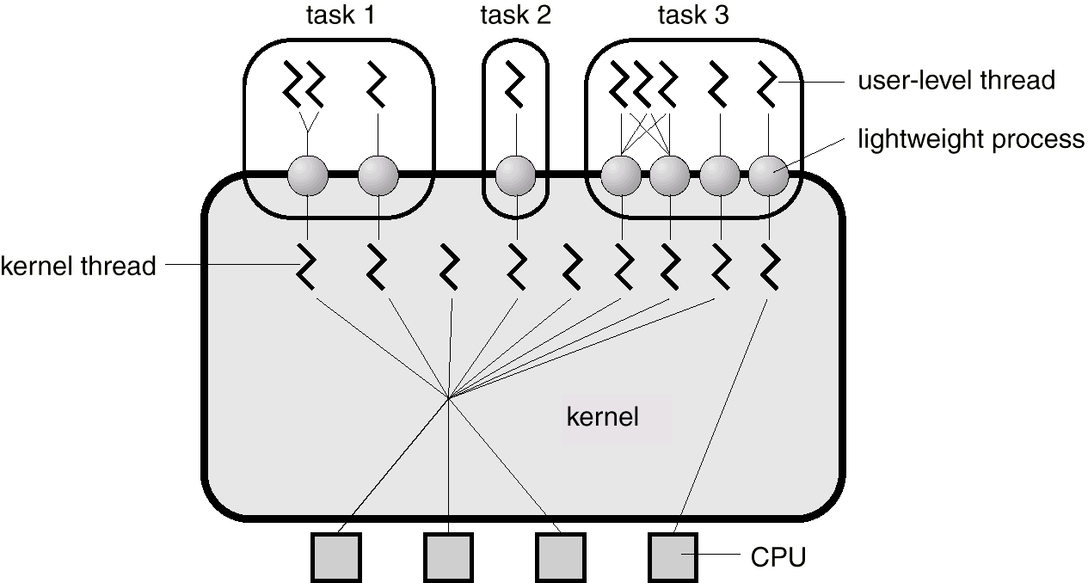
Solaris 2 Threads

Slide 28
Interprocess Communication (IPC)
Mechanism for processes to communicate and to synchronize their actions.
Message system – processes communicate with each other without resorting to shared variables.
IPC facility provides two operations:
  send(message) – message size fixed or variable
  receive(message)
If P and Q wish to communicate, they need to:
  establish a communication link between them
  exchange messages via send/receive
Implementation of communication link
  physical (e.g., shared memory, hardware bus)
  logical (e.g., logical properties)

Slide 29
Implementation Questions
How are links established?
Can a link be associated with more than two processes?
How many links can there be between every pair of communicating processes?
What is the capacity of a link?
Is the size of a message that the link can accommodate fixed or variable?
Is a link unidirectional or bi-directional?

Slide 30
Direct Communication
Processes must name each other explicitly:
  send (P, message) – send a message to process P
  receive(Q, message) – receive a message from process Q
Properties of communication link
  Links are established automatically.
  A link is associated with exactly one pair of communicating processes.
  Between each pair there exists exactly one link.
  The link may be unidirectional, but is usually bi-directional.

Slide 31
Indirect Communication
Messages are directed and received from mailboxes (also referred to as ports).
  Each mailbox has a unique id.
  Processes can communicate only if they share a mailbox.
Properties of communication link
  Link established only if processes share a common mailbox
  A link may be associated with many processes.
  Each pair of processes may share several communication links.
  Link may be unidirectional or bi-directional.
Operations
  create a new mailbox
  send and receive messages through mailbox
  destroy a mailbox

Slide 32
Indirect Communication (Continued)
Mailbox sharing
  P₁, P₂, and P₃ share mailbox A.
  P₁, sends; P₂ and P₃ receive.
  Who gets the message?
Solutions
  Allow a link to be associated with at most two processes.
  Allow only one process at a time to execute a receive operation.
  Allow the system to select arbitrarily the receiver. Sender is notified who the receiver was.

Slide 33
Buffering
Queue of messages attached to the link; implemented in one of three ways.
  1. Zero capacity – 0 messages
  Sender must wait for receiver (rendezvous).
  2. Bounded capacity – finite length of n messages
  Sender must wait if link full.
  3. Unbounded capacity – infinite length
  Sender never waits.

Slide 34
Exception Conditions – Error Recovery
Process terminates
Lost messages
Scrambled Messages

